Slide 1
Hojicha Oat Latte Laun
Hojicha Oat Latte: A $40K Fall Launch
Worth approving — 6-week campaign targeting office workers aged 25–35
Tsukiao Coffee · Management Review

Slide 2
Hojicha Oat Latte Laun
Agenda
Deck Route: From Trend to Approval
Five sections over 12 slides, ending in the $40K decision
Section | Focus | Slides
Why now | Oat milk and hojicha category trends | 3–5
Product and audience fit | Hojicha oat latte for office workers 25–35 | 6
6-week launch plan | Three phases with milestones | 7–8
Budget and channels | $40K across social, events, delivery apps | 9–10
Targets and next steps | 20,000 cups, 5,000 members, weekly tracking | 11–12
Decision ask comes on slide 12: approve $40K
02

Slide 3

Hojicha Oat Latte Laun
Market Evidence
Oat milk is the default alt-milk in coffee
Category-level data shows oat is the plant milk to build on
33%
$598M
+0.9%
of coffee orders
refrigerated oat milk
oat growth
Oat leads alt-milk picks vs almond at 10%
Grew 10.5% over 52 weeks to Oct 2023
Only major plant milk growing; others fell 7.2%
Sources: SPINS 2023, Square 2024, Circana 2024
03

Slide 4





Hojicha Oat Latte Laun
Growth Bet
Hojicha Rises While Matcha Matures
Category data points to hojicha as the next wave
Matcha under strain
Hojicha momentum
Mellow energy
Flavor cues align
Consumers seek low-caffeine mellow energy; hojicha is the next Japanese tea to watch
Roasted flavor cues +25.9%, cozy cues +32.5% — a natural fall fit
Matcha is mature volume (+61% share) but demand has strained Japanese tea supply
Social mentions up 76.4% YoY; still in 'trending' lifecycle phase
04

Slide 5
Hojicha Oat Latte Laun
Who we target
25–35 office workers sit at the crossroads of oat milk and hojicha trends
Square, Tastewise 2024–25
05

Slide 6
Product fit
“
Low caffeine for afternoons, mellow roast meets oat creaminess — the hojicha oat latte fills the gap between matcha and coffee
— Tastewise 2025

Slide 7
Hojicha Oat Latte Laun
6-Week Plan
Launch Runs 6 Weeks in Three Phases
Three phases, each with a milestone gate to review spend
1
2
3
✓
Tease & Awaken
Launch Push
Sustain & Convert
Milestone Gates
Weeks 1–2: social teasers build cozy fall awareness
Weeks 3–4: full push plus in-store sampling events
Weeks 5–6: sustain buzz, convert buyers to members
Each phase ends with a checkpoint to adjust spend
07

Slide 8
Phase Milestones: Three Checkpoints
Adjust the plan at each gate — reallocating underperforming channels keeps the $40K on target
Week 2
Week 4
Week 6
Each gate
Awareness Gate
Mid-Point Gate
Final Gate
Rebalance Rule
Check reach and teaser engagement baseline; shift social spend if early signals lag
Cumulative 10,000 cups — half the first-month target reached; rebalance channels
Track 20,000 cups and 5,000 new members; confirm conversion and retention follow-up
Underperforming channels rebalanced at every checkpoint to protect the budget

Slide 9

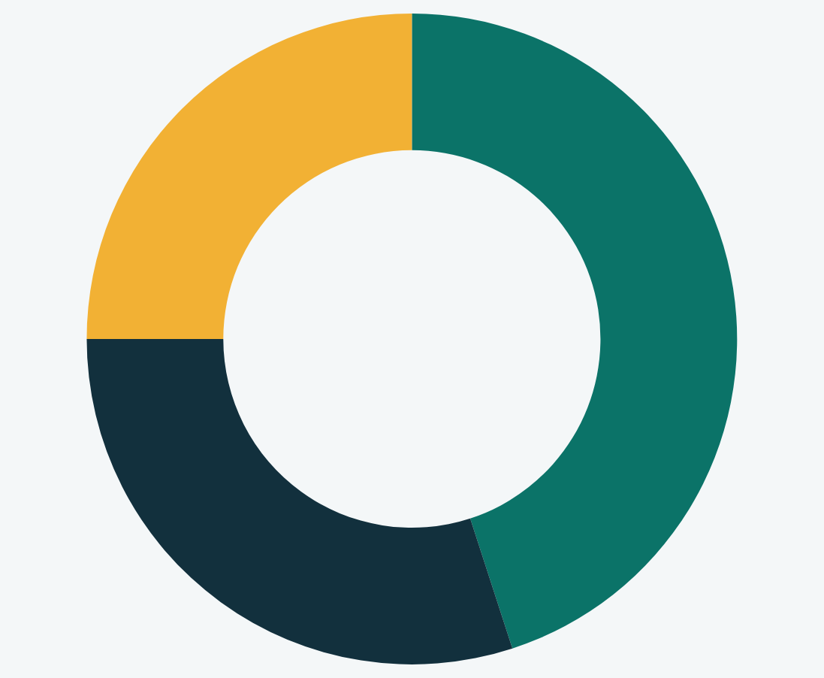
Hojicha Oat Latte Laun
Where the $40K goes
Social media is the largest budget item
Budget skews to social media; events and delivery apps support sampling
Budget allocation by channel
$18K of $40K goes to social media: teaser, launch, retargeting
Social media
18$K
45%
In-store events
12$K
30%
Delivery apps
10$K
25%
Reallocation checkpoints at week 2 and week 4 gates
09

Slide 10





Hojicha Oat Latte Laun
Channel roles
Each Channel Carries a Distinct Funnel Job
Social builds awareness, events create trial, delivery apps drive repeat
Social: Awareness
Delivery Apps: Repeat
Events: Trial
Member Signup
In-store sampling and ritual moments; a 5-day free-upgrade LTO lifted add-on units 60%
Offered at every trial touchpoint to convert first cups into 5,000 members
Cozy fall storytelling; seasonal campaigns have driven 850M+ paid impressions
Repeat orders plus office-bulk bundles for 25–35 workers ordering 3–4x per week
10

Slide 11
Both Targets Tracked Weekly Against Spend
One dashboard, two KPIs, weekly read on cost efficiency
Metric | Target | Weekly pace | Tracking method
Cups sold | 20,000 in month one | ~3,300 per week | POS volume by channel
New members | 5,000 signups | 25% of cups converting | Signup rate at register and in-app
Cost per cup | Within $2.00 budget share | Blended across channels | Spend logged weekly per channel
Cost per member | Within $8.00 budget share | By acquisition channel | Attribution codes in dashboard
Weekly dashboard shared with management team; checkpoints allow mid-flight budget shifts

Slide 12
Hojicha Oat Latte Laun
Decision
Approve $40K to Hit 20,000 Cups and 5,000 Members
The trends, the plan and the targets all point to a go this week
Trend tailwind
Oat milk leads coffee orders at 33%; hojicha mentions up 76.4% YoY
Phased plan
6 weeks in 3 phases with three spending checkpoints to adjust
Budget split
$18K social media, $12K in-store events, $10K delivery apps
First-month KPIs
20,000 cups sold and 5,000 new members, tracked weekly vs spend
Approve the budget this week to start teasers
12

